Slide 1
IT Security Hashing and MAC
Michael Claudius, Associate Professor, Roskilde

Slide 2
Problems with Integrity and Authentication
Make sure the message/documents (m) has not been changed/tampered
Make sure sender is sender (Bob) and receiver is receiver (Alice)
Lets look a little deeper into the problem and solutions
What we need is a fingerprint/DNA of message/document
This is done by using a cryptographic hash function (H)
H produce a hash value H(m)
Special Issues
Find a fast and secure hash function, i.e. high security strength
Length extension attacks
Playback attacks

Slide 3
Security Strengths of Approved Hash Functions
An approved hash function is expected to have the following three properties:
Collision resistance: It is computationally infeasible to find two different inputs (m1, m2) to the hash function that have the same hash value.
Preimage resistance: Given a randomly chosen hash value, it is computationally infeasible to find an input message that hashes to this hash value.
Second preimage resistance: It is computationally infeasible to find a second input that has the same hash value as any other specified input.

Slide 4
Resistance types
The difference the choice/knowledge of message m1, m2
In the first case (collision resistance), the attacker can freely choose both messages m1 and m2, with the only requirement that they are different (and hash to the same value).
In the second case the attacker is handed a random H(m1) value and tries to find m1.
In the third case (second preimage resistance), the attacker is handed a fixed m1, H(m1) to which he has to find a different m2 with equal hash. In particular, he can't choose m1.

Slide 5
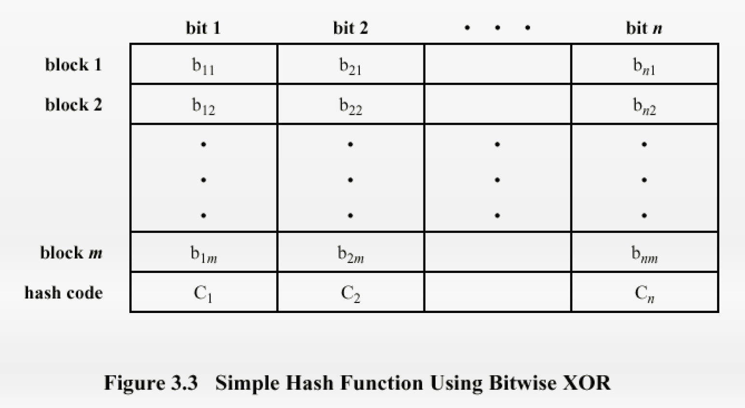
Simple Hash Function
Simple Hash function using bit-wise XOR on one block
Improve by one bit circular shift after the block has been processed
For each n-bit block of data:
  Rotate the current hash vqlue to the left by one bit
  XOR the block into that hash.

Slide 6
Simple Hash Function
Simple Hash function using bit-wise XOR on one block
Improve by one bit circular shift after the block has been processed
For each n-bit block of data:
  Rotate the current hash value to the left by one bit
  XOR the block into that hash.

Slide 7
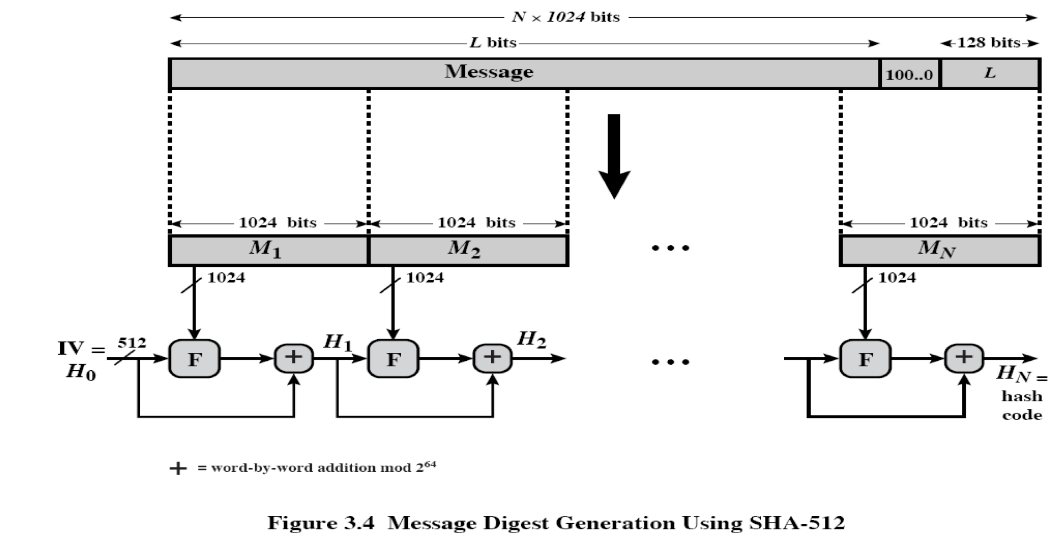
SHA512 processing on a message
Message M is divided into blocks (M1, M2, ….) of 1024 bit length
The last block is padded by 10000.. to adjust the size
L is the length of the message 2^128 bit max
Each block M1..Mn is manipulated by a function F
Outcome is of F is added with previous hash (Hi-1)
+ means word-by-word addition modulus 2^64
Final output is the 512 bit message digest a hash value
So whats inside the function ??

Slide 8
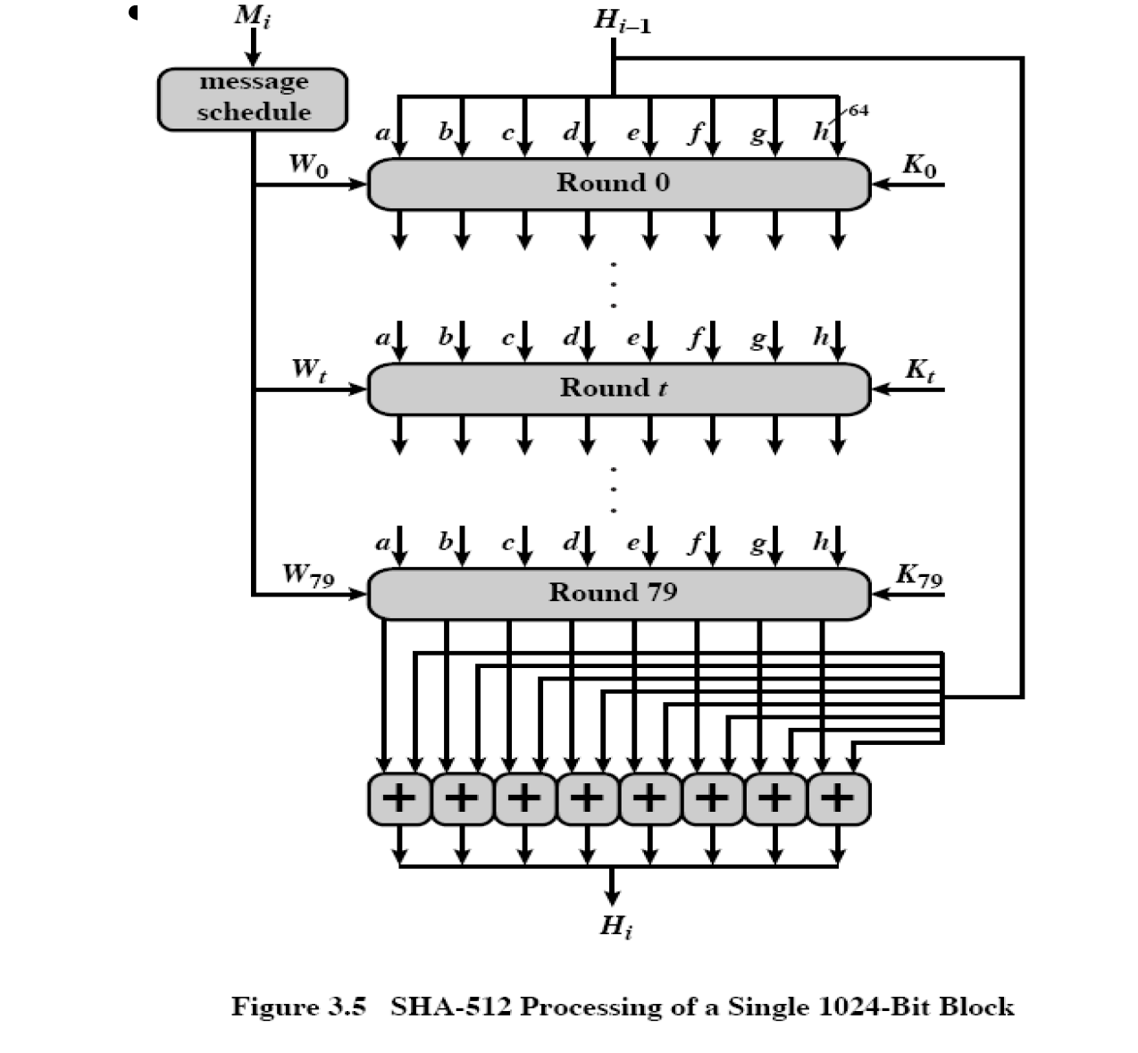
SHA512 function on one block
Message M is divided into blocks (M1, M2, ….) of 1024 bit length
Each block is distributed into 80 words (W0…W79)
Copy block (1024) into the first 16 words (16x64=1024) W0..W15
Extend/manipulate the 16 words into the last W16..W79
Previous hash (Hi-1) is placed in registers abcdef of 64 bit length
80 rounds is done
Each round using a constant Ki, a word Wi, abcdef
  A round is a sequence of operations performed multiple times
  to thoroughly mix up the data until it's unrecognizable.
K0..K79 is the fractional cube root of the first 80 primes: 1,2,5,7…
Outcome round 79 is added with previous hash (Hi-1)
+ means word-by-word addition modulus 2^64
Final output is the 512 bit message digest
Every bit is a function of all input bits !

Slide 9
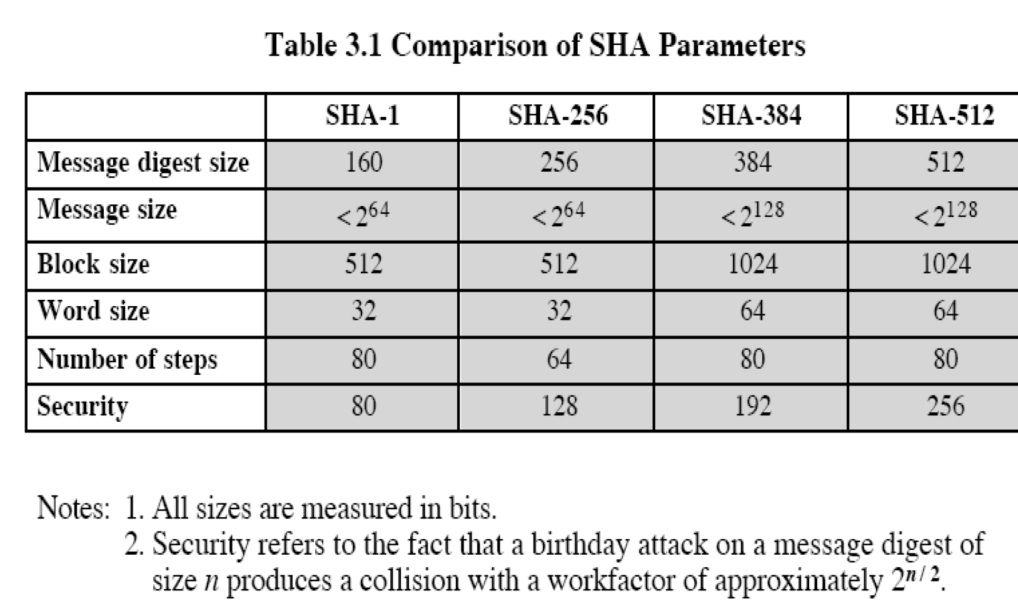
SHA algorithms
Comparing of SHA parameters
The higher digest size the better security and lower speed
BUT sensitive to length extension attacks, lets look at that

Slide 10
MAC Message Authentication Code
If A sends m,H(m) to B
Intruder Trudy can easily send another message m’,H(m‘) claiming she is A
Need a secret key K: s
Create a MAC = H(m+s)
But its also sensitive to length attacks
Lets look at that
  https://en.wikipedia.org/wiki/Length_extension_attack
Solution HMAC

Slide 11
HMAC Hash Message Authentication Code
If A sends m,H(m) to B
Intruder Trudy can easily send another message m’,H(m‘) claiming she is A
Need a secret key K: s
Create a MAC = H(m+s)
But its also sensitive to length attacks
Lets look at that
  https://en.wikipedia.org/wiki/Length_extension_attack
Solution HMAC

Slide 12
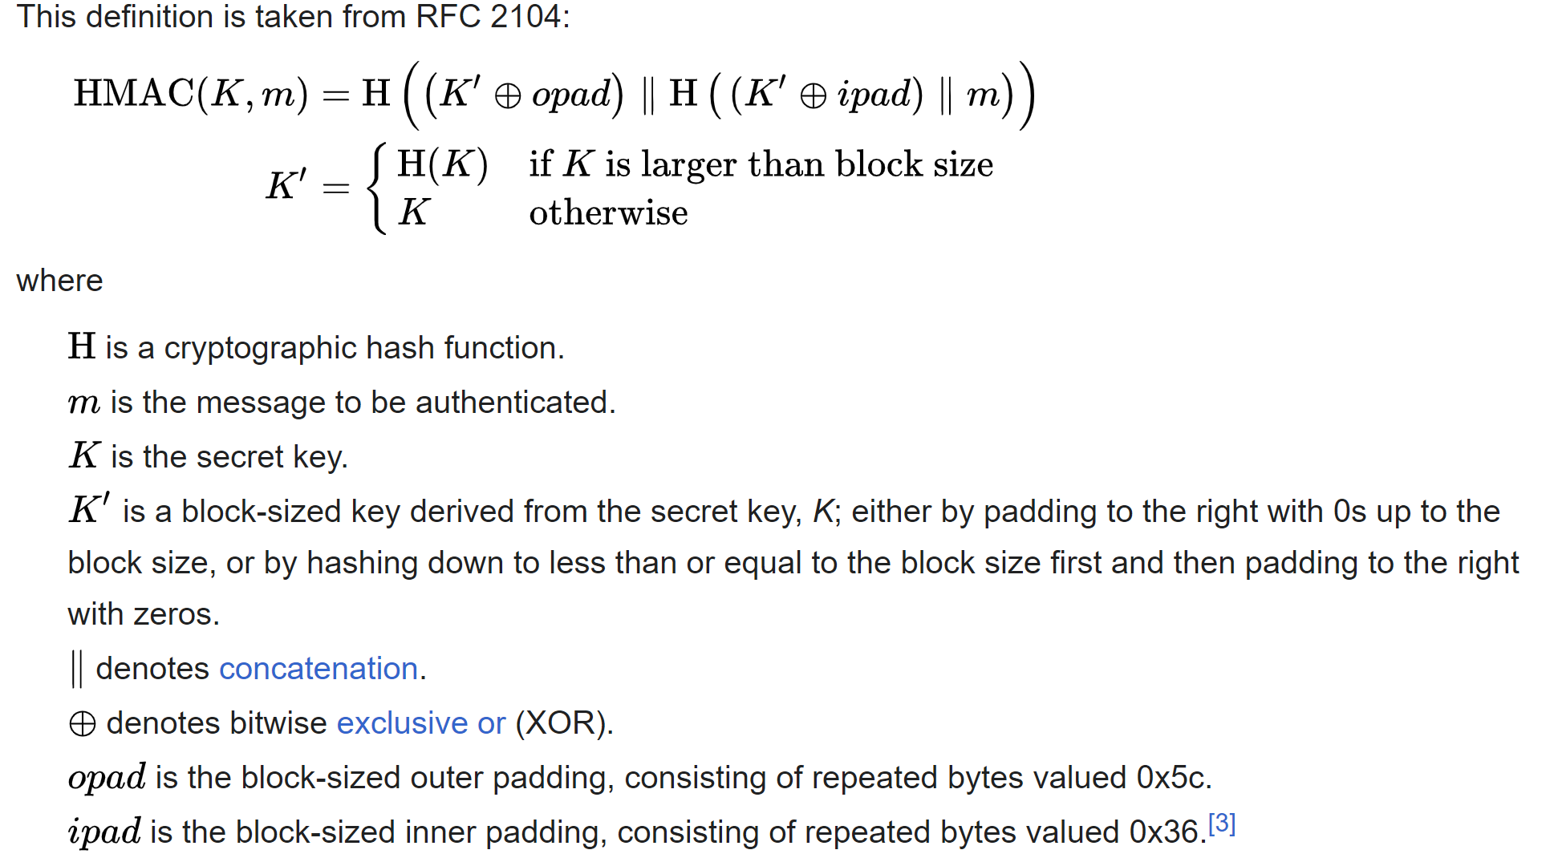
HMAC Hash Message Authentication Code
Definition of HMAC
BUT what about playback attacks?
Solution is a adding a nounce R to m+s
This is explained next week about length extension attacks, lets look at that

Slide 13

Exercise
It is time for discussion, applying hashing algorithms
Also we will investigate the Homework 1 exercise !!
Lab Cryptool 2
  Look at details, but don’t loose the overview ☺
  Just follow the ”right” track and you find the gold

